Slide 1
Act’v group of schools operational workshop
Duties of administrators
Prepared by : Ndwalaza t. Mr

Slide 2
Financial duties of a school head
. Chief Accounting officer of the school who accounts for the school revenue and how it is spent
Prepares the school budget, - a record of projected revenue and expenditure
Ensures that school funds are used for the right purpose
Ensures that teachers salaries are in line with level set by the department as well as ensure staff comply with the employment terms and conditions of the department
Reporting the use of funds to the relevant authority (responsible authority)
Conduct fundraising ventures and make sure that the funds are used for the purposes meant for.
Reviewing and analyzing income and expenditure on a regular basis ensuring that resource allocation follows the school development plan

Slide 3

FINANCIAL DUTIES OF A HEAD

Slide 4
Managerial duties of a school head
Oversees the school
Develop , refine and propagate the vision ,mission, values and goals of the school
Maintain accurate personnel ,enrolment. Financial and other records

Slide 5
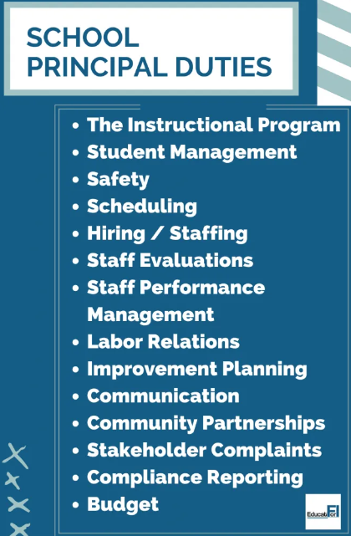
ADMINISTRATIVE DUTIES OF A HEAD

Slide 6
Financial duties of a deputy head
Procuring and distributing teaching and learning material in consultation with the school head, tics, hods etc
Monitoring and assisting in the education production and other fundraising activities
Chairs the procurement meeting

Slide 7
Managerial duties of a deputy head
Conducting induction and orientation of new pupils and teachers
Organizing and monitoring co-curricular activities
Monitoring the development and maintenance of school grounds
Ensuring that official records are kept up to date
Attending to disciplinary matters of pupils and staff and chairing the disciplinary committee and reporting recommendations to the school head
Ensuring that the school buildings ,furniture equipment and other facilities are maintained in desirable state of repair

Slide 8
Duties of tics/hods
Leads and supervises their department
Mobilizes and manages resources for the department
Identifies non readers/ and those with learning challenges in the department and draws up remedial programme for those learner eg.(Eri)

Slide 9
conclusion
Every administrator has a huge role to play if the school is to succeed
An administrator who doesn’t play his part well draws back the smooth function of the school
Our schools are business entities hence we need to make sure we guard our finances with jealous for the good of its employees as for its continued existence

